Slide 1
第三部分 类图的实例
动态增减属性
地理信息元数据模型

Slide 2
动态增减属性
数据库中的基本单位是表，表的基本成分是属性（表的项或列）。表的列数是固定的。但是，可以通过程序来实现“动态”增减表项。
在类图模型中如何表示属性的动态增减？

Slide 3
可动态增减属性的对象
AnyType
公司
属性模板
公司名称
*
-属性名称:String
-属性值：AnyType
{ordered}
属性（属性名称）
Create(AnyType);
SetValue（AnyType nalue）;
GetValue(): Anyype;
ChangeName(String name);
*
公司属性
《bind》
<Atype>
每个记录中的属性个数、每个属性的名称和类型都可以不同。

Slide 4
用构造型定义可变属性对象
《可变属性对象》
公司
属性变更
可变属性对象
管理员
基本属性：
-公司名称:String
可变属性：
{对新增属性：老对象的该属性为空；
对已删除属性：老对象的该属性无效；}

Slide 5
可变属性表的类模型
AnyType
可变属性表
实体动态属性
表名称
*
-属性名称:String
-属性值：AnyType
{ordered}
属性（属性名称）
Create();
SetValue（AnyType nalue）;
GetValue(): AnyType;
ChangeName(String name);

Slide 6
地理信息元数据模型
Geographic Information --Metadata

Slide 7
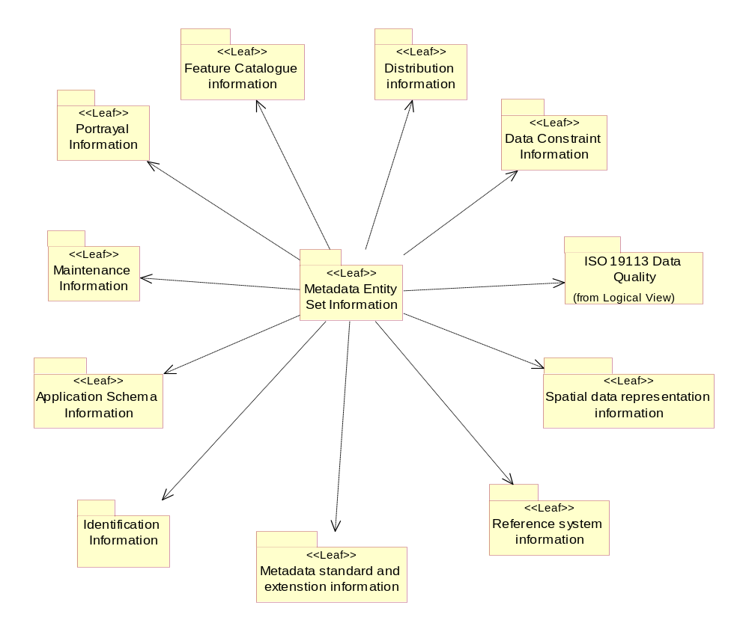

Slide 8
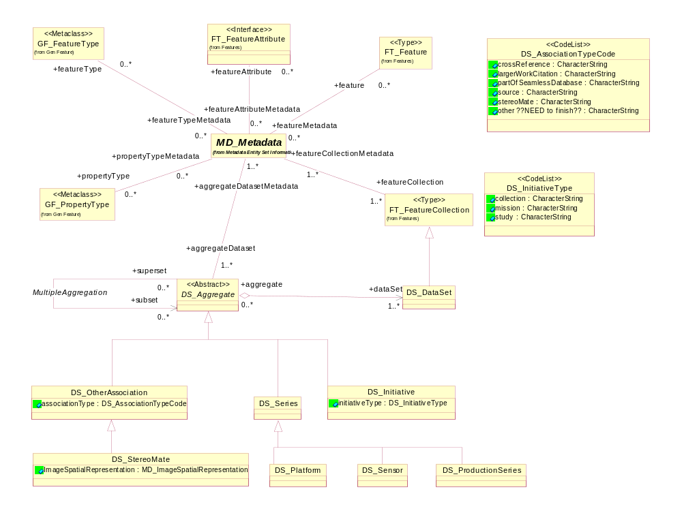

Slide 9
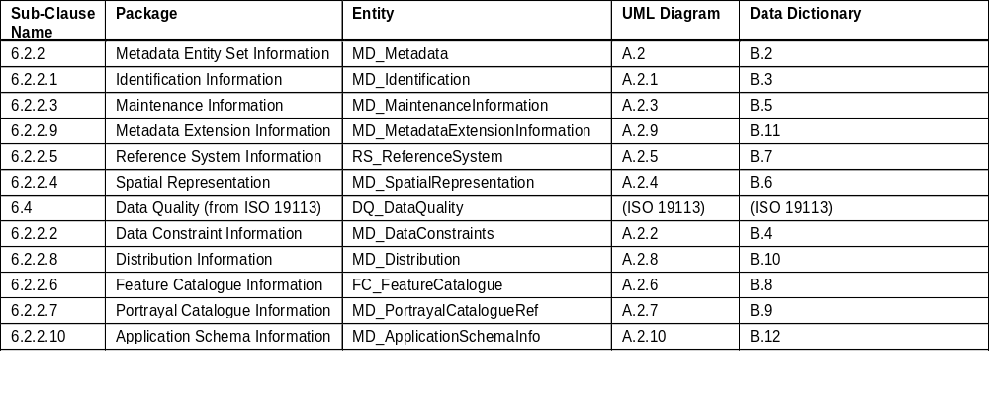
Metadata package and entity relationship

Slide 10
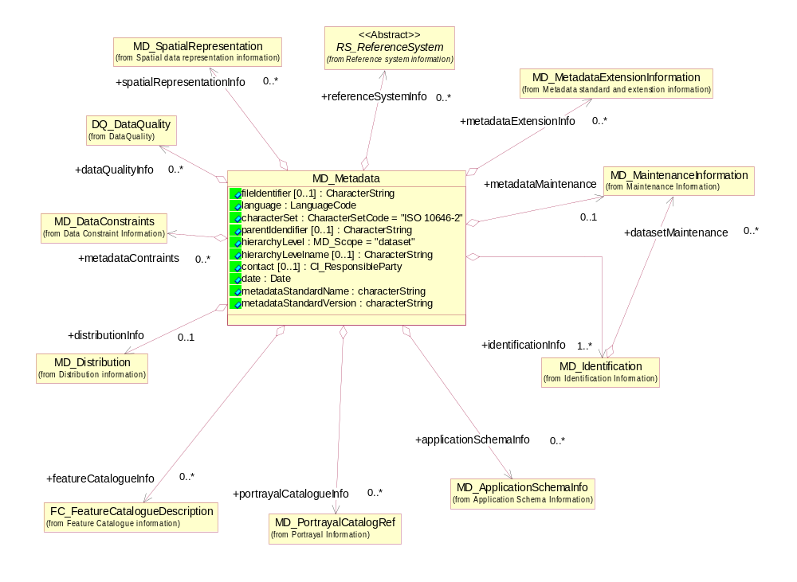

Slide 11
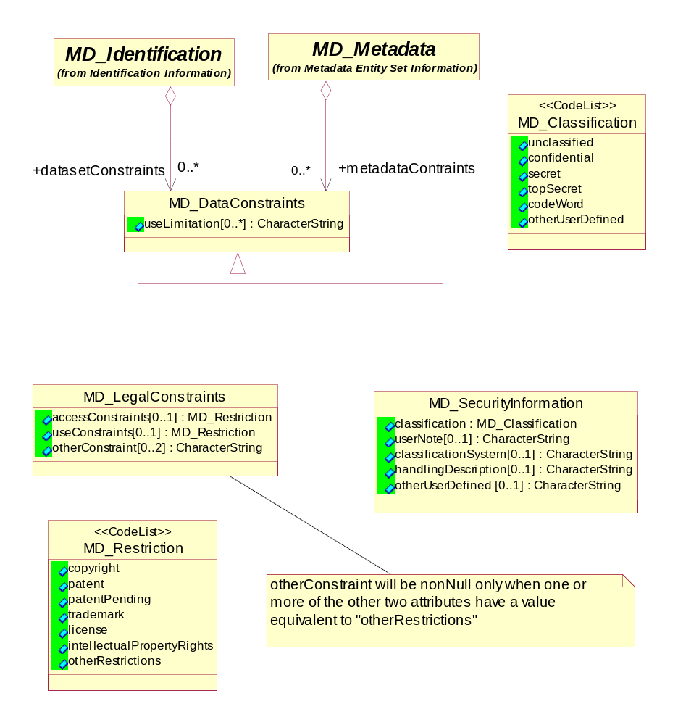

Slide 12
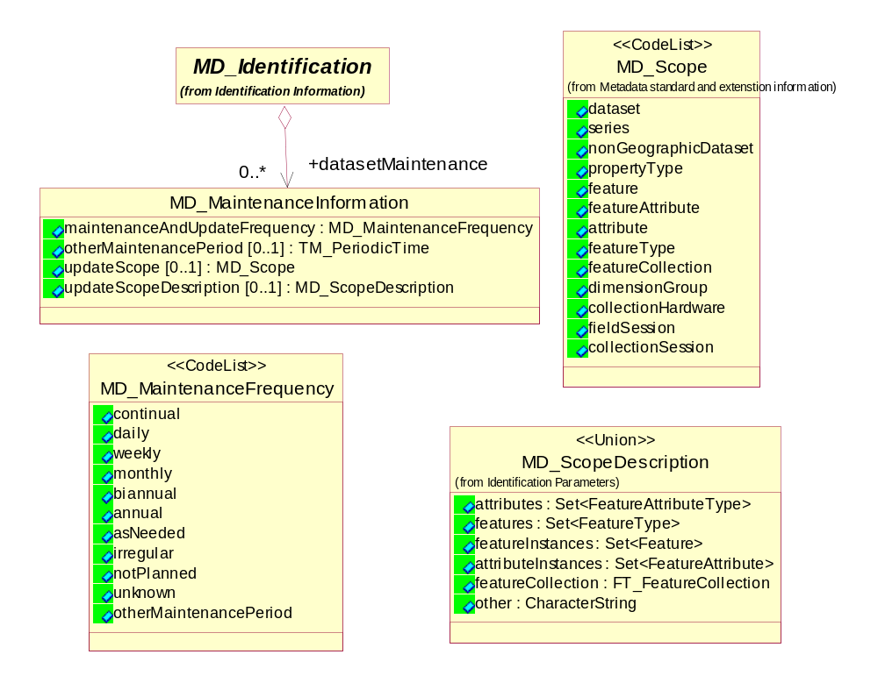

Slide 13
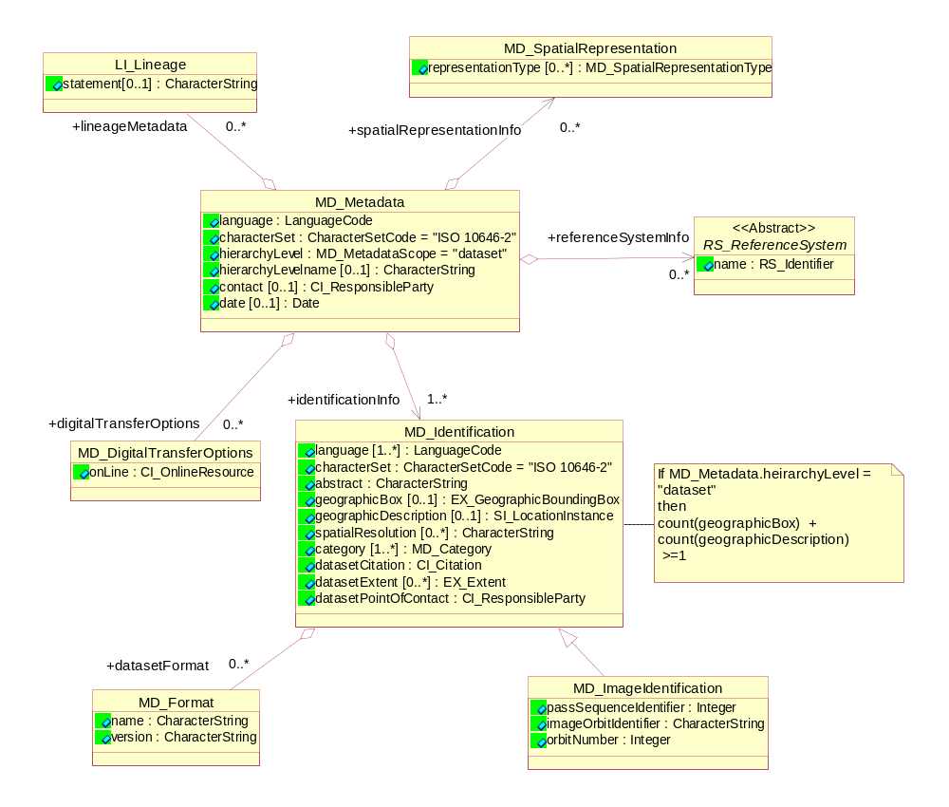

Slide 14
Essential metadata application schema – Element list
MD_Metadata
language: LanguageCode
characterSet: CharacterSetCode
hierarchyLevel: MD_Scope
hierarchyLevelName: CharacterString
contact: (optional)
CI_ResponsibleParty
mandantoryParty:
CI_MandantoryParty; organisationName: CharacterString
responsibility: CI_ResponsibilityCode
contactInfo: (optional)
CI_Contact
phone:
CI_Telephone; voice: CharacterString; facimile: CharacterString
address:
        CI_Address; deliveryPoint: CharacterString; city: CharacterString
administrativeArea: CharacterString; postalCode: CharacterString
country: CharacterString; electronicMailAddress: CharacterString
onlineResource:
CI_OnlineResource; linkage: URL

Slide 15
date: Date (optional)
+ identificationInfo
MD_Identification
language: LanguageCode
characterSet: CharacterSetCode
abstract: CharacterString
geographicBox: (and/or geographicDescription)
      EX_GeographicBoundingBox
westBoundLongitude: Angle
eastBoundLongitude: Angle
northBoundLatitude: Angle
soundBoundLatitude: Angle
geographicDescription: (and/or geographicBox)
SI_LocationInstance
      geographicIdentifier: CharacterString ; spatialResolution: (optional) CharacterString
category: MD_Category
datasetCitation:
CI_Citation
title: CharacterString
date: Date
edition: CharacterString

Slide 16
datasetExtent: (optional)
EX_Extent
description: CharacterString
+element (may sub-type as either EX_BoundingPolygon, EX_GeographicBoundingBox
        or Set<SI_LocationInstance)
EX_BoundingPolygon ; extentType: EX_ExtentType ; polygon: GM_Object
+element
        EX_GeographicBoundingBox
extentType: EX_ExtentType ; westBoundLongitude: Angle
eastBoundLongitude: Angle ; northBoundLatitude: Angle
soundBoundLatitude: Angle
+element
        Set<SI_LocationInstance>
SI_LocationInstance ; geographicIdentifier:

Slide 17
CharacterString
+element
EX_TemporalExtent ; extent: TM_Primitive
+element
EX_VerticalExtent ; minimumValue: Real ; maximumValue: Real
unitOfMeasure: UomLength
+verticalDatum
SC_VerticalDatum

Slide 18
datasetPointOfContact:
CI_ResponsibleParty
        mandantoryParty:
        CI_MandantoryParty
        individualName: CharacterString
        organisationName: CharacterString
        positionName: CharacterString
        responsibility: CI_ResponsibilityCode
        contactInfo: (optional)
        CI_Contact
phone:
CI_Telephone
voice: CharacterString
facimile: CharacterString
address:
        CI_Address
deliveryPoint: CharacterString
city: CharacterString
administrativeArea: CharacterString
postalCode: CharacterString
country: CharacterString
electronicMailAddress: CharacterString
onlineResource:
CI_OnlineResource
linkage: URL

Slide 19
+ referenceSystemInfo (optional)
RS_ReferenceSystem
name:
RS_Identifier (one element required, may use both)
identifier: CharacterString
citation:
CI_Citation
title: CharacterString
date: Date
edition: CharacterString
+ spatialRepresentationInfo (optional)
MD_SpatialRepresentation
representationType: MD_SpatialRepresentationType
+ lineageMetadata (optional)
LI_Lineage
statement: CharacterString
+digitalTransferOptions (optional)
MD_DigitalTransferOptions
onLine:
CI_OnlineResource
linkage: URL
+datasetFormat (optional)
MD_Format
name: CharacterString
version: CharacterString

